Slide 1
EE-357: CCN Mobile Radio Propagation: Large Scale Path Loss
Hassaan Khaliq Qureshi
School of Electrical Engineering & Computer Science
National University of Sciences & Technology (NUST)
Pakistan

Slide 2
Credits and Acknowledgements
Throughout this course, I will be borrowing examples, explanations and figures from the following books:
Rappaport, Wireless Communications, Prentice Hall, 2002.
Wireless Communications and Networks by William Stallings.
I will also be borrowing examples and figures from the online course material provided by Prof. Andrea Goldsmith, Stanford University
In this particular lecture, I will be borrowing concepts and figures from the Advanced Communication Systems Course by Dr. Syed Ali Khayam who taught this course 2 years back.
I am also borrowing figures from Mike Willis’s online tutorial: http://www.mike-willis.com/Tutorial/PF7.htm

Slide 3
What will we cover in this lecture?
This lecture will cover some basic details on propagation and the largescale propagation effects that are commonly observed on a wireless communication system:
Modes of Propagation and some basic concepts
Free-Space Propagation
Isotropic and Directional Antennas
Terrestrial Propagation: Large Scale Physical Models
Reflection and Diffraction

Slide 4
Diffraction: Phase Difference
To compute ∆d, let us consider propagating from point T to R
An obstruction is blocking the LoS path
The obstruction has a circular radius, h
R
Q
h
O
d₂
T
d₁

Slide 5
Diffraction: Phase Difference
Any wave propagating through TQR is traveling more distance that TOR
R
Q
h
O
d₂
T
d₁

Slide 6
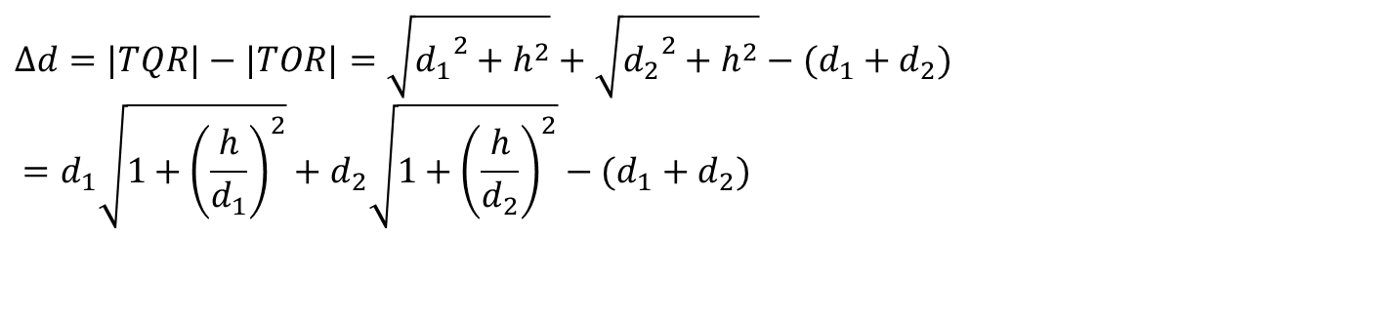
Diffraction: Phase Difference
$$Δd=|TQR|−|TOR|=\sqrt{{d_{1}}^{2}+h^{2}}+\sqrt{{d_{2}}^{2}+h^{2}}−(d_{1}+d_{2}) \\ =d_{1}\sqrt{1+{\left(\frac{h}{d_{1}}\right)}^{2}}+d_{2}\sqrt{1+{\left(\frac{h}{d_{2}}\right)}^{2}}−(d_{1}+d_{2})$$
R
Q
h
O
d₂
T
d₁

Slide 7
Diffraction: Phase Difference

Slide 8
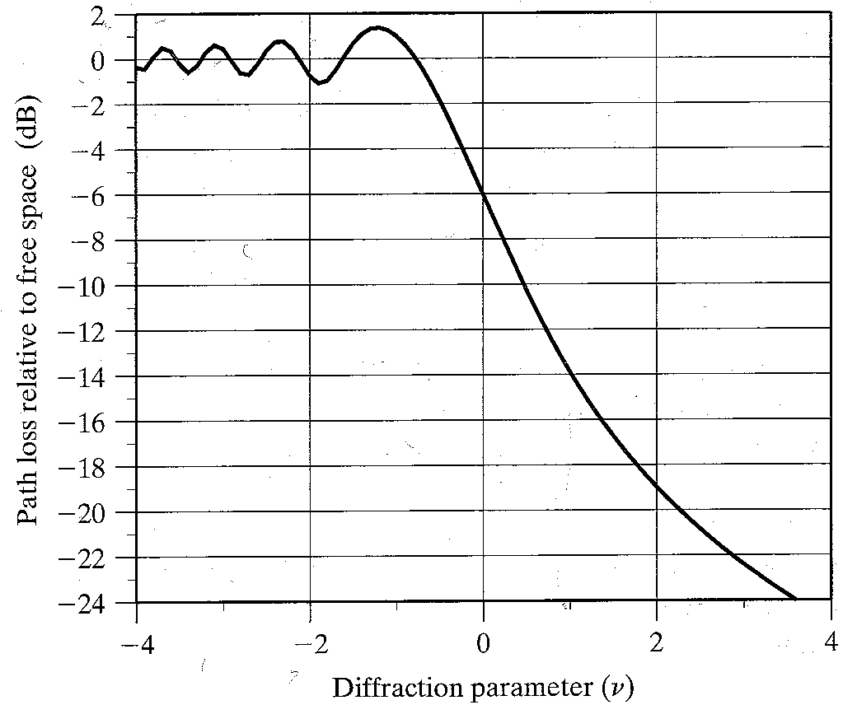
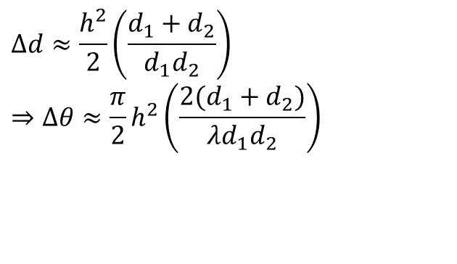

Diffraction: Phase Difference
$$Δd≈\frac{h^{2}}{2}\left(\frac{d_{1}+d_{2}}{d_{1}d_{2}}\right) \\ ⇒Δθ≈\frac{π}{2}h^{2}\left(\frac{2(d_{1}+d_{2})}{λd_{1}d_{2}}\right)$$
We define the Fresnel-Kirchhoff diffraction parameter as:
$$υ=h\sqrt{\frac{2(d_{1}+d_{2})}{λd_{1}d_{2}}} \\ ⇒Δθ≈\frac{π}{2}υ^{2}$$

Slide 9
Example
Find the phase difference introduced in the following scenario when the carrier frequency f_{c} = 900 MHz.
R
Q
h = 50mm
O
d₂ = 200m
T
d₁ = 300m
Notes:
392.5 *10-6

Slide 10
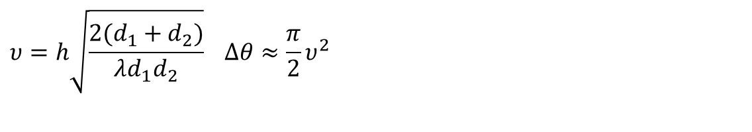
Diffraction: Phase Difference
$$υ=h\sqrt{\frac{2(d_{1}+d_{2})}{λd_{1}d_{2}}} Δθ≈\frac{π}{2}υ^{2}$$
Fresnel-Kirchhoff diffraction parameter characterizes the phase difference between the LoS and a diffracted path
R
Q
h
O
d₂
T
d₁
Notes:
It is better to call this height as +h since it is above the lOS path between T and R.

Slide 11
Diffraction: Fresnel Zones
We are interested in answering two completely separate questions:
What is the impact of height +h (unknown till yet) on Diffraction losses?
- the ellipsoidal shape is dependent on h. the greater the h, the larger the ellipsoid and higher the Fresnel zone and so the losses.
What is the impact on LOS communication in the presence of any height h (+ive, -ive, or zero)
- for that we want to get the first Fresnel zone clear from obstruction.
R
h
d₂
O
T
d₁
Notes:
Fresenal zones represent successive regions where secondary waves have a path length from the transmitter to the receiver which are n lembda/2 greater than the total path length of a LOS Path.
In the case h is fixed, the circular shape also increases in case we (either T or R) move more and more closely towards h.

Slide 12
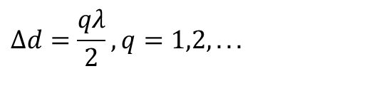
Diffraction: Fresnel Zones
Let us define a series of circular holes on the obstruction such that the length of each diffracted path is
$$Δd=\frac{qλ}{2}, q=1,2,...$$
Fresnel zones represent successive regions where secondary waves have a path length from the transmitter to the receiver, which are qλ /2 greater than the total path length of a LOS Path.
R
h
O
d₂
T
d₁
Notes:
Fresenal zones represent successive regions where secondary waves have a path length from the transmitter to the receiver which are n lembda/2 greater than the total path length of a LOS Path.

Slide 13
Diffraction: Fresnel Zones
Circles on the obstruction with an excess length equal to an integer multiple of half wavelengths define a series of concentric ellipsoids
Site A
d1
Site B
Image courtesy of Lecture on Wireless Communication Systems, University of Surrey
d2

Slide 14
Diffraction: Fresnel Zones
Circles on the obstruction with an excess length equal to an integer multiple of half wavelengths define a series of concentric ellipsoids
Volume enclosed be q-th ellipsoid is called the q-th Fresnel Zone
R
O
T

Slide 15
Diffraction: Fresnel Zones
R
First Fresnel Zone
Second Fresnel Zone
O
Third Fresnel Zone
T

Slide 16
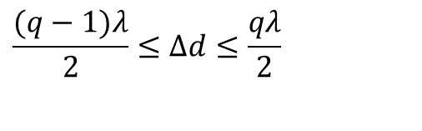

Diffraction: Fresnel Zones
Since q is an integer, the path length difference (from the LoS path) of the q-th Fresnel zone is
And the corresponding phase difference is
$$\frac{(q−1)λ}{2}≤Δd≤\frac{qλ}{2}$$
$$(q−1)π≤Δθ≤qπ$$
R
First Fresnel Zone
O
Second Fresnel Zone
Third Fresnel Zone
T

Slide 17

Diffraction: Fresnel Zones
$$(q−1)π≤Δθ≤qπ$$
Every Fresnel zone is introducing a phase difference of π
Thus successive Fresnel zones are in phase opposite directions and interfere destructively.
R
First Fresnel Zone
O
Second Fresnel Zone
Third Fresnel Zone
T

Slide 18
Radius of FZ

Slide 19
Diffraction: Fresnel Zones
Fresnel zones can be thought of as containing the propagated energy of the wave.
A general rule of thumb is that:
We must keep the first Fresnel zone free of obstructions to obtain transmission under free-space conditions
R
First Fresnel Zone
O
Second Fresnel Zone
Third Fresnel Zone
T

Slide 20
Diffraction: Fresnel Zones
Any obstructions which do not enter the 1st Fresnel zone have little effect on the signal
A clearance of at least 0.6r₁ (r₁: radius of first Fresnel zone) is ensured in practical microwave links
Forbidden Region
First Fresnel Zone
r₁
0.6r₁
Notes:
If unobstructed, radio waves will travel in a straight line from the transmitter to the receiver. But if there are obstacles near the path, the radio waves reflecting off those objects may arrive out of phase with the signals that travel directly and reduce the power of the received signal. On the other hand, the reflection can enhance the power of the received signal if the reflection and the direct signals arrive in phase. Sometimes this results in the counterintuitive finding that reducing the height of an antenna increases the signal-to-noise ratio.
Fresnel provided a means to calculate where the zones are, where a given obstacle will cause mostly in phase or mostly out of phase reflections between the transmitter and the receiver. Obstacles in the first Fresnel zone will create signals that will be 0 to 90 degrees out of phase, in the second zone they will be 90 to 270 degrees out of phase, in third zone, they will be 270 to 450 degrees out of phase and so on. Even numbered zones have the maximum phase cancelling effect and odd numbered zones may actually add to the signal power

Slide 21
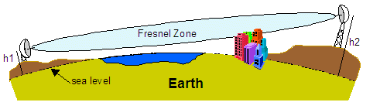
Diffraction: Fresnel Zones
If there are obstacles near the path, the radio waves reflecting off those objects may arrive out of phase with the signals that travel directly and reduce the power of the received signal.
On the other hand, reduction in the height of the antenna causes an increase in the signal to noise ratio.
Notes:
When antennas are at different heights. We take help from similar triangles and calculate h [can also be called as the midway LOS point above the obstruction ] or the Obstruction point that comes between the LOS point. With the help of that point or height which comes in meters, we subtract the first Fresnel zone and then compare it with the Obstruction height. If Obstruction height (which is given) is greater than the result obtained, then LOS communication is not possible.
Actually the main problem in case of different antenna heights is the unknown factor called LOS point [above the obstruction] which is unknown in case of different antenna heights. We first find the LOS point and then substract the calculated first fresenal zone from it. If the given obstruction height is great then the result, LOS is not possible.

Slide 22
Exercise
A company owns two office towers in a city and wants to set up a 4-GHz microwave link between the two towers. The two towers have heights of 10m each, and are separated by 2 km. In the line of sight (LOS) and midway between the two towers is a third tower of height 7.5 meters. Will line-of-sight transmission be possible between the two towers? Justify your answer. Describe an engineering solution to obtain line-of-sight transmission.
Notes:
Alpha and beta are same (similar triangle), therefore h can be calculated.

Slide 23
Exam Question [different S and R]
A company owns two office towers in a city and wants to set up a 4-GHz microwave link between the two towers. The two towers have heights of 100m and 50 m, and are separated by 3 km. In the line of sight (LOS) and midway between the two towers is a third tower of height 70 meters. Will line-of-sight transmission be possible between the two towers? Justify your answer. Describe an engineering solution to obtain line-of-sight transmission
Notes:
Alpha and beta are same (similar triangle), therefore h can be calculated.

